Slide 1
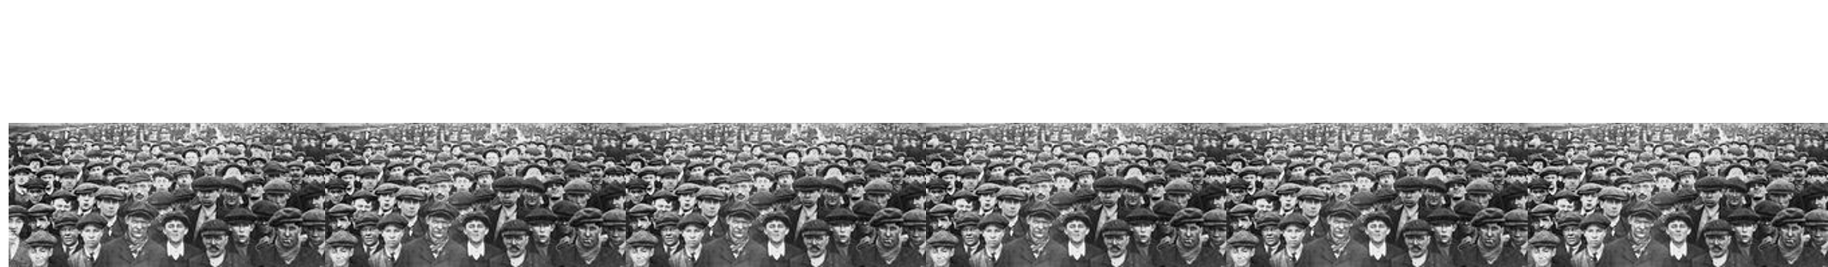
TECHNOLOGY
SCIENCE
SOCIAL STRUCTURES
ECONOMY
SURYA KOCHERLAKOTA

Slide 2
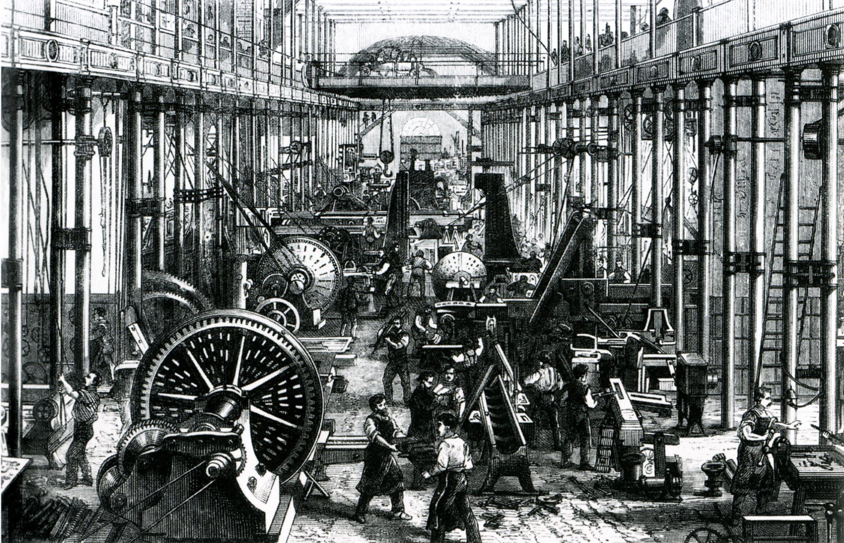
NOT SO INDUSTRIAL REVOLUTION
SURYA KOCHERLAKOTA

Slide 3
NEW TECHNOLOGIES
NEW SOCIAL CLASSES
NEW ECONOMIC STRUCTURES
SURYA KOCHERLAKOTA

Slide 4
NEW SOCIAL CLASSES
NEW ECONOMIC STRUCTURES
NEW TECHNOLOGIES
SURYA KOCHERLAKOTA

Slide 5
NEW SOCIAL CLASSES
ENCLOSURES
WORKING CLASS
COLONIES
SURYA KOCHERLAKOTA

Slide 6
NEW ECONOMIC STRUCTURES
WAGES
CAPITALISM
SURYA KOCHERLAKOTA

Slide 7
NEW TECHNOLOGY
WATT ENGINE
LANCASHIRE COTTON
SURYA KOCHERLAKOTA

Slide 8
FURTHER READING
J. M. Blaut, “The colonizer's model of the world,” 1993, pp. 152-179.
W. Dalrymple, “The East India Company: The original corporate raiders”.
E. Hobsbawm, “The Age of Revolution: Europe 1789–1848,” 1962.
J. Schumpeter, “ Imperialism,” 1919, pp. 66-73.
E. P. Thompson, “The Making of the English Working Class,” 1963.
Picture: Sächsische Maschinenfabrik in Chemnitz
SURYA KOCHERLAKOTA

Slide 9
SURYA KOCHERLAKOTA
Dept. of Electrical and Electronic Engineering
Imperial College London
ssk114@ic.ac.uk
linkedin.com/in/suryakocherlakota

